Slide 1
The Value of Location: What Matters Most for Older Individuals Considering Relocation in Sweden?

Slide 2
Examining heterogeneity in housing preferences among older adults in Sweden.
What’s this paper about?
Sample
Results
Direction and aim of the paper

Slide 3
DCE – a recap
Respondents were asked to select the most attractive housing options between two alternatives in a choice set.
The alternatives only differed in the levels of housing attributes and price.
We use this data to estimate a model that measures the effect the attribute levels have on the probability of choosing one choice set alternative over another.
This probability is interpreted as utility – levels that increase the probability of choosing one alternative over another provide more utility.
We can further estimate willingness-to-pay values from the model coefficients.

Slide 4
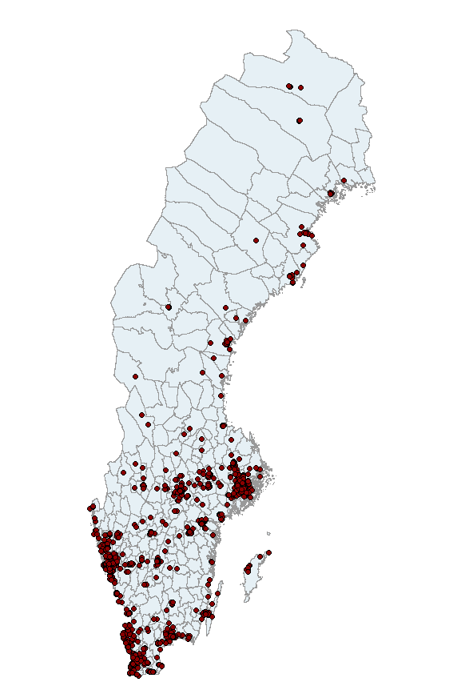
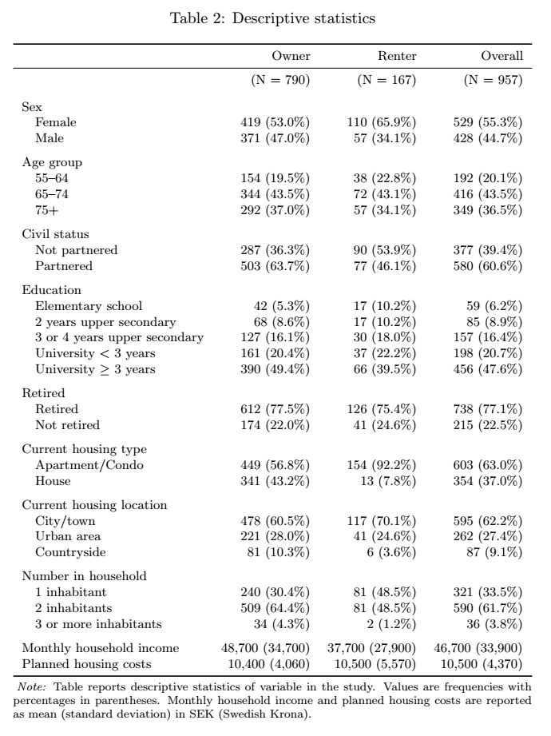

Slide 5
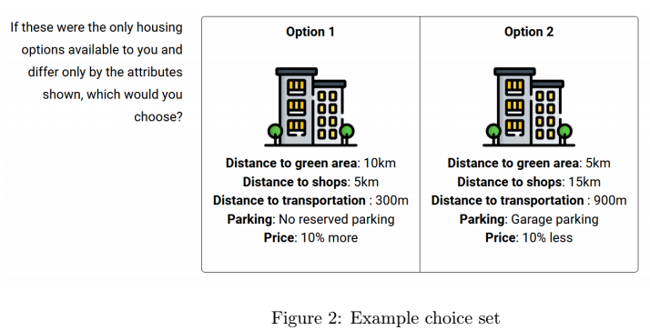
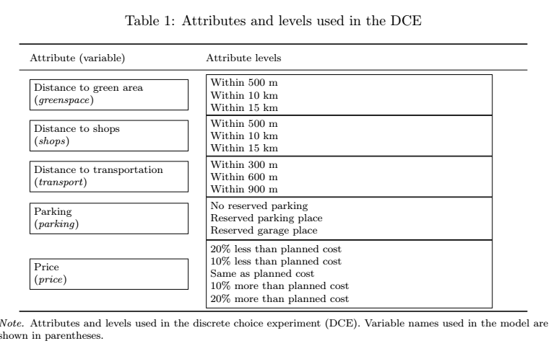

Slide 6
Analysis – What have we done so far?
Approach mirrors that of Caplan et al (2021):
Focuses on renters and owners
Estimates baseline models, calculating WTP values
Adds interaction terms that allow to sus out heterogenous effects

Slide 7
Models
Multinomial Logit (MNL) is common in discrete choice experiments
It assumes everyone values attributes the same way.
In reality, people differ and preferences vary by person or group.
Mixed Logit (ML) Models relax this restriction:
Allow individual differences in preferences.
Handle repeated choices from the same person.
Offer more realistic and flexible results.
Here we move from the “average person” to “each person has their own taste.” – Essential for us as our aim is to uncover different tastes
ML models take more time to compute as they use simulations to estimate maximum likelihood.

Slide 8
Steps to get to Willingness-to-pay
Estimate a Mixed Logit model
Recall that the price coefficient is in percentage terms in 10% intervals
Divide the level coefficients by the price coefficient to get a Marginal rate of substitution (MRS). This represents the percentage change (in 10% intervals) respondents are willing to pay for an attribute level.
Divide the MRS by 10 (to adjust for the 10% intervals) and multiply by the average planned housing cost to get a Marginal Willingness-to-Pay (MWTP) value in Swedish krona.

Slide 9
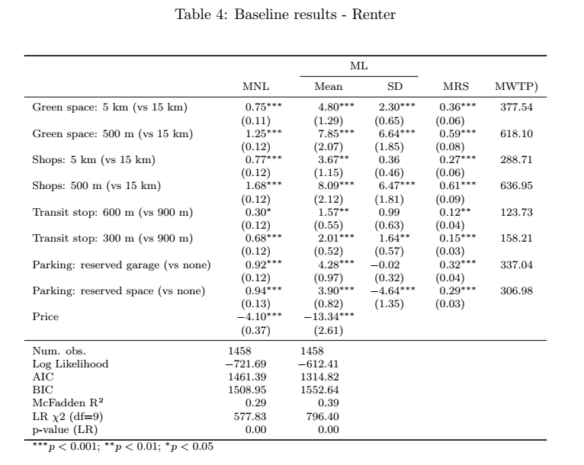




MRS = 8.09 / 13.34 = 0.61
MWTP = 0.61 / 10 x 10500 ≈ 636
”Renters are willing to pay 636 sek a month to be closer to shops”
”Renters on average are willing to pay 636 more a month to reside within 500m of shops instead of 15km away from shops”

Slide 10
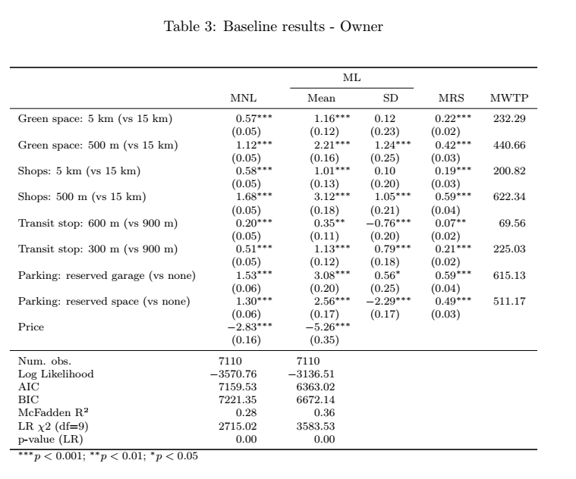






”Owners are willing to pay 278 sek more a month than Renters (615-337) to have a reserved garaged space (compared to none)”

Slide 11
Adding interaction terms
Splitting the sample into subsamples and running test on each one is one strategy for uncovering differences in our sample. (i.e. Renters vs. Owners)
Alternatively, we can run one model on the entire sample and add interaction terms with the attribute levels and a dummy group variable.
This allows us to test if the differences are significant.
Unfortunately, interpretation gets a bit muddy with many interaction terms.
Note: the unit of analysis is at the choice level, not the individual. This means we cannot add control variables as in traditional regression models as they do not fluctuate between the choice sets. Any individual level variables (sex, education, etc) can only be entered into the model as interactions with the attribute levels.

Slide 12
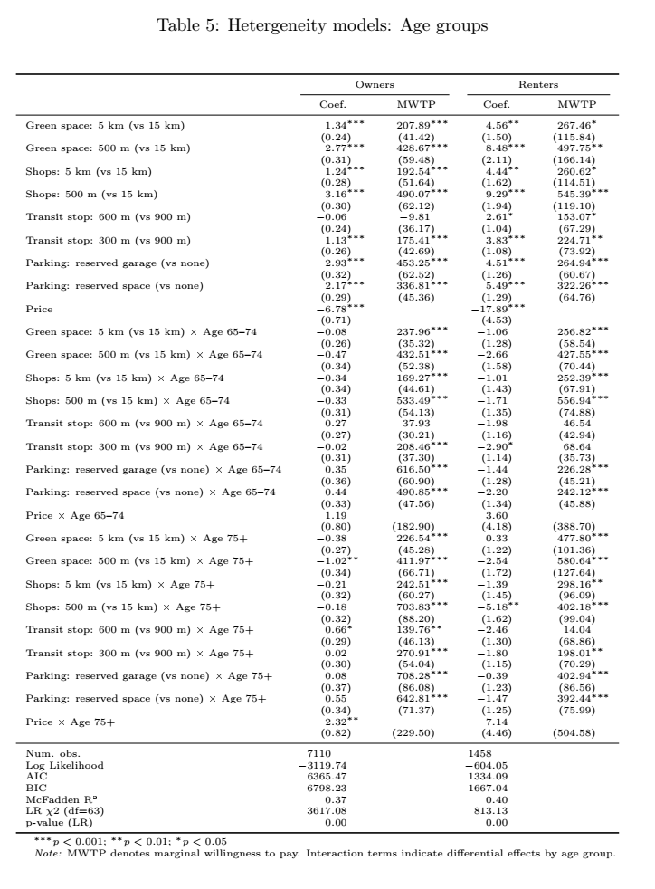
Here we extend the baseline tests, adding interaction terms of a new variable Age Group and the attribute levels
Recall that for categorical variables, they are interpreted in comparison to a reference (base) level.
Adding interactions adds another level of complexity in interpretation. We take are now comparing the variables coeffceints with the attribute reference level (no parking vs garage) AND the base level of the added variable – here age groups.
”Among the Renters willing to pay more for a reserved garage place, those aged 55-64 are willing to pay 264 sek more, those aged 65-74 are willing to pay 226 sek more, and those aged 75+ are willing to pay 402 sek more a month”
Interpretation becomes less straight-forward…

Slide 13
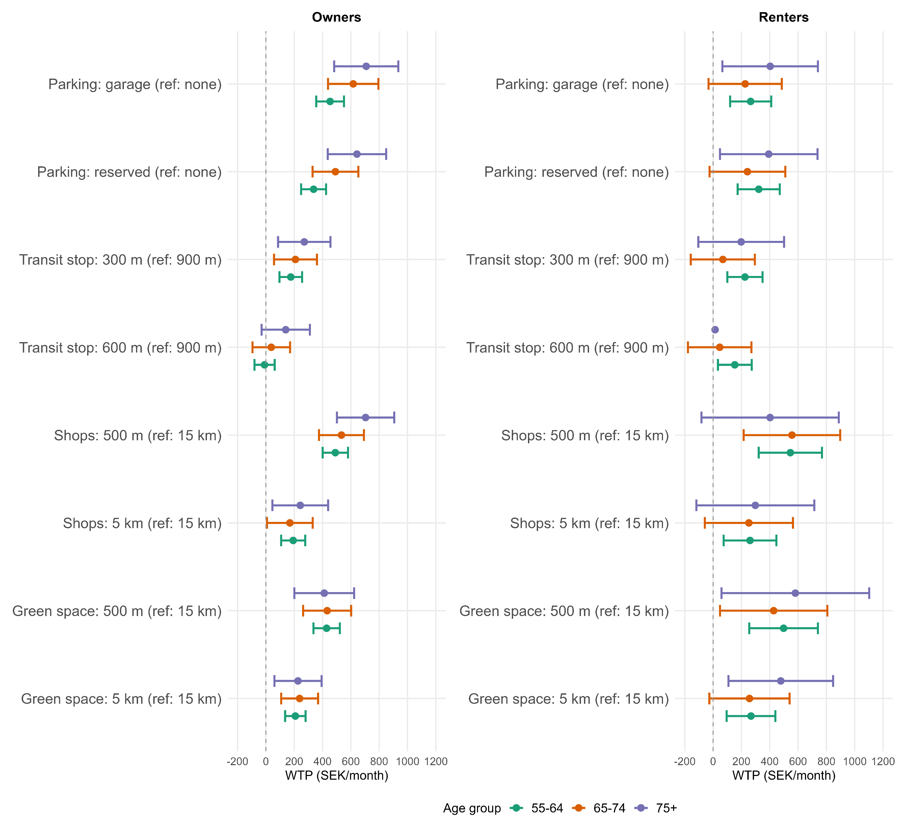

Slide 14
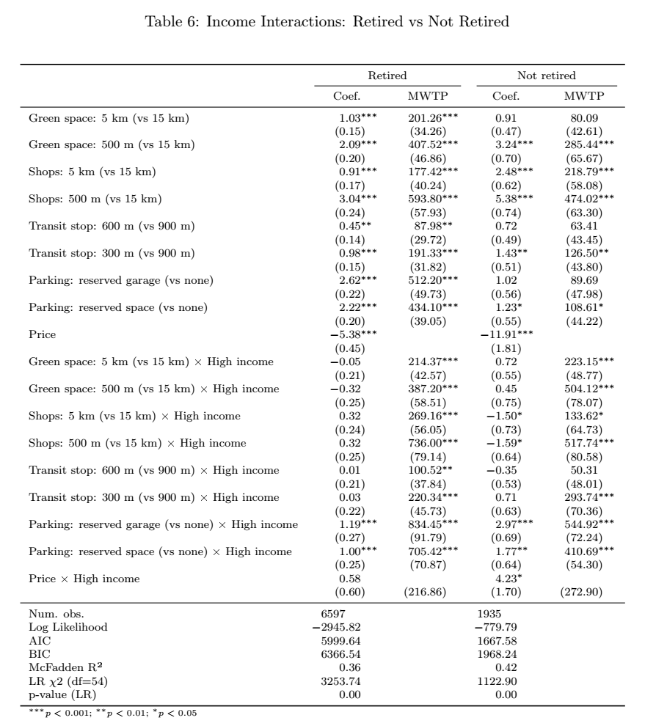
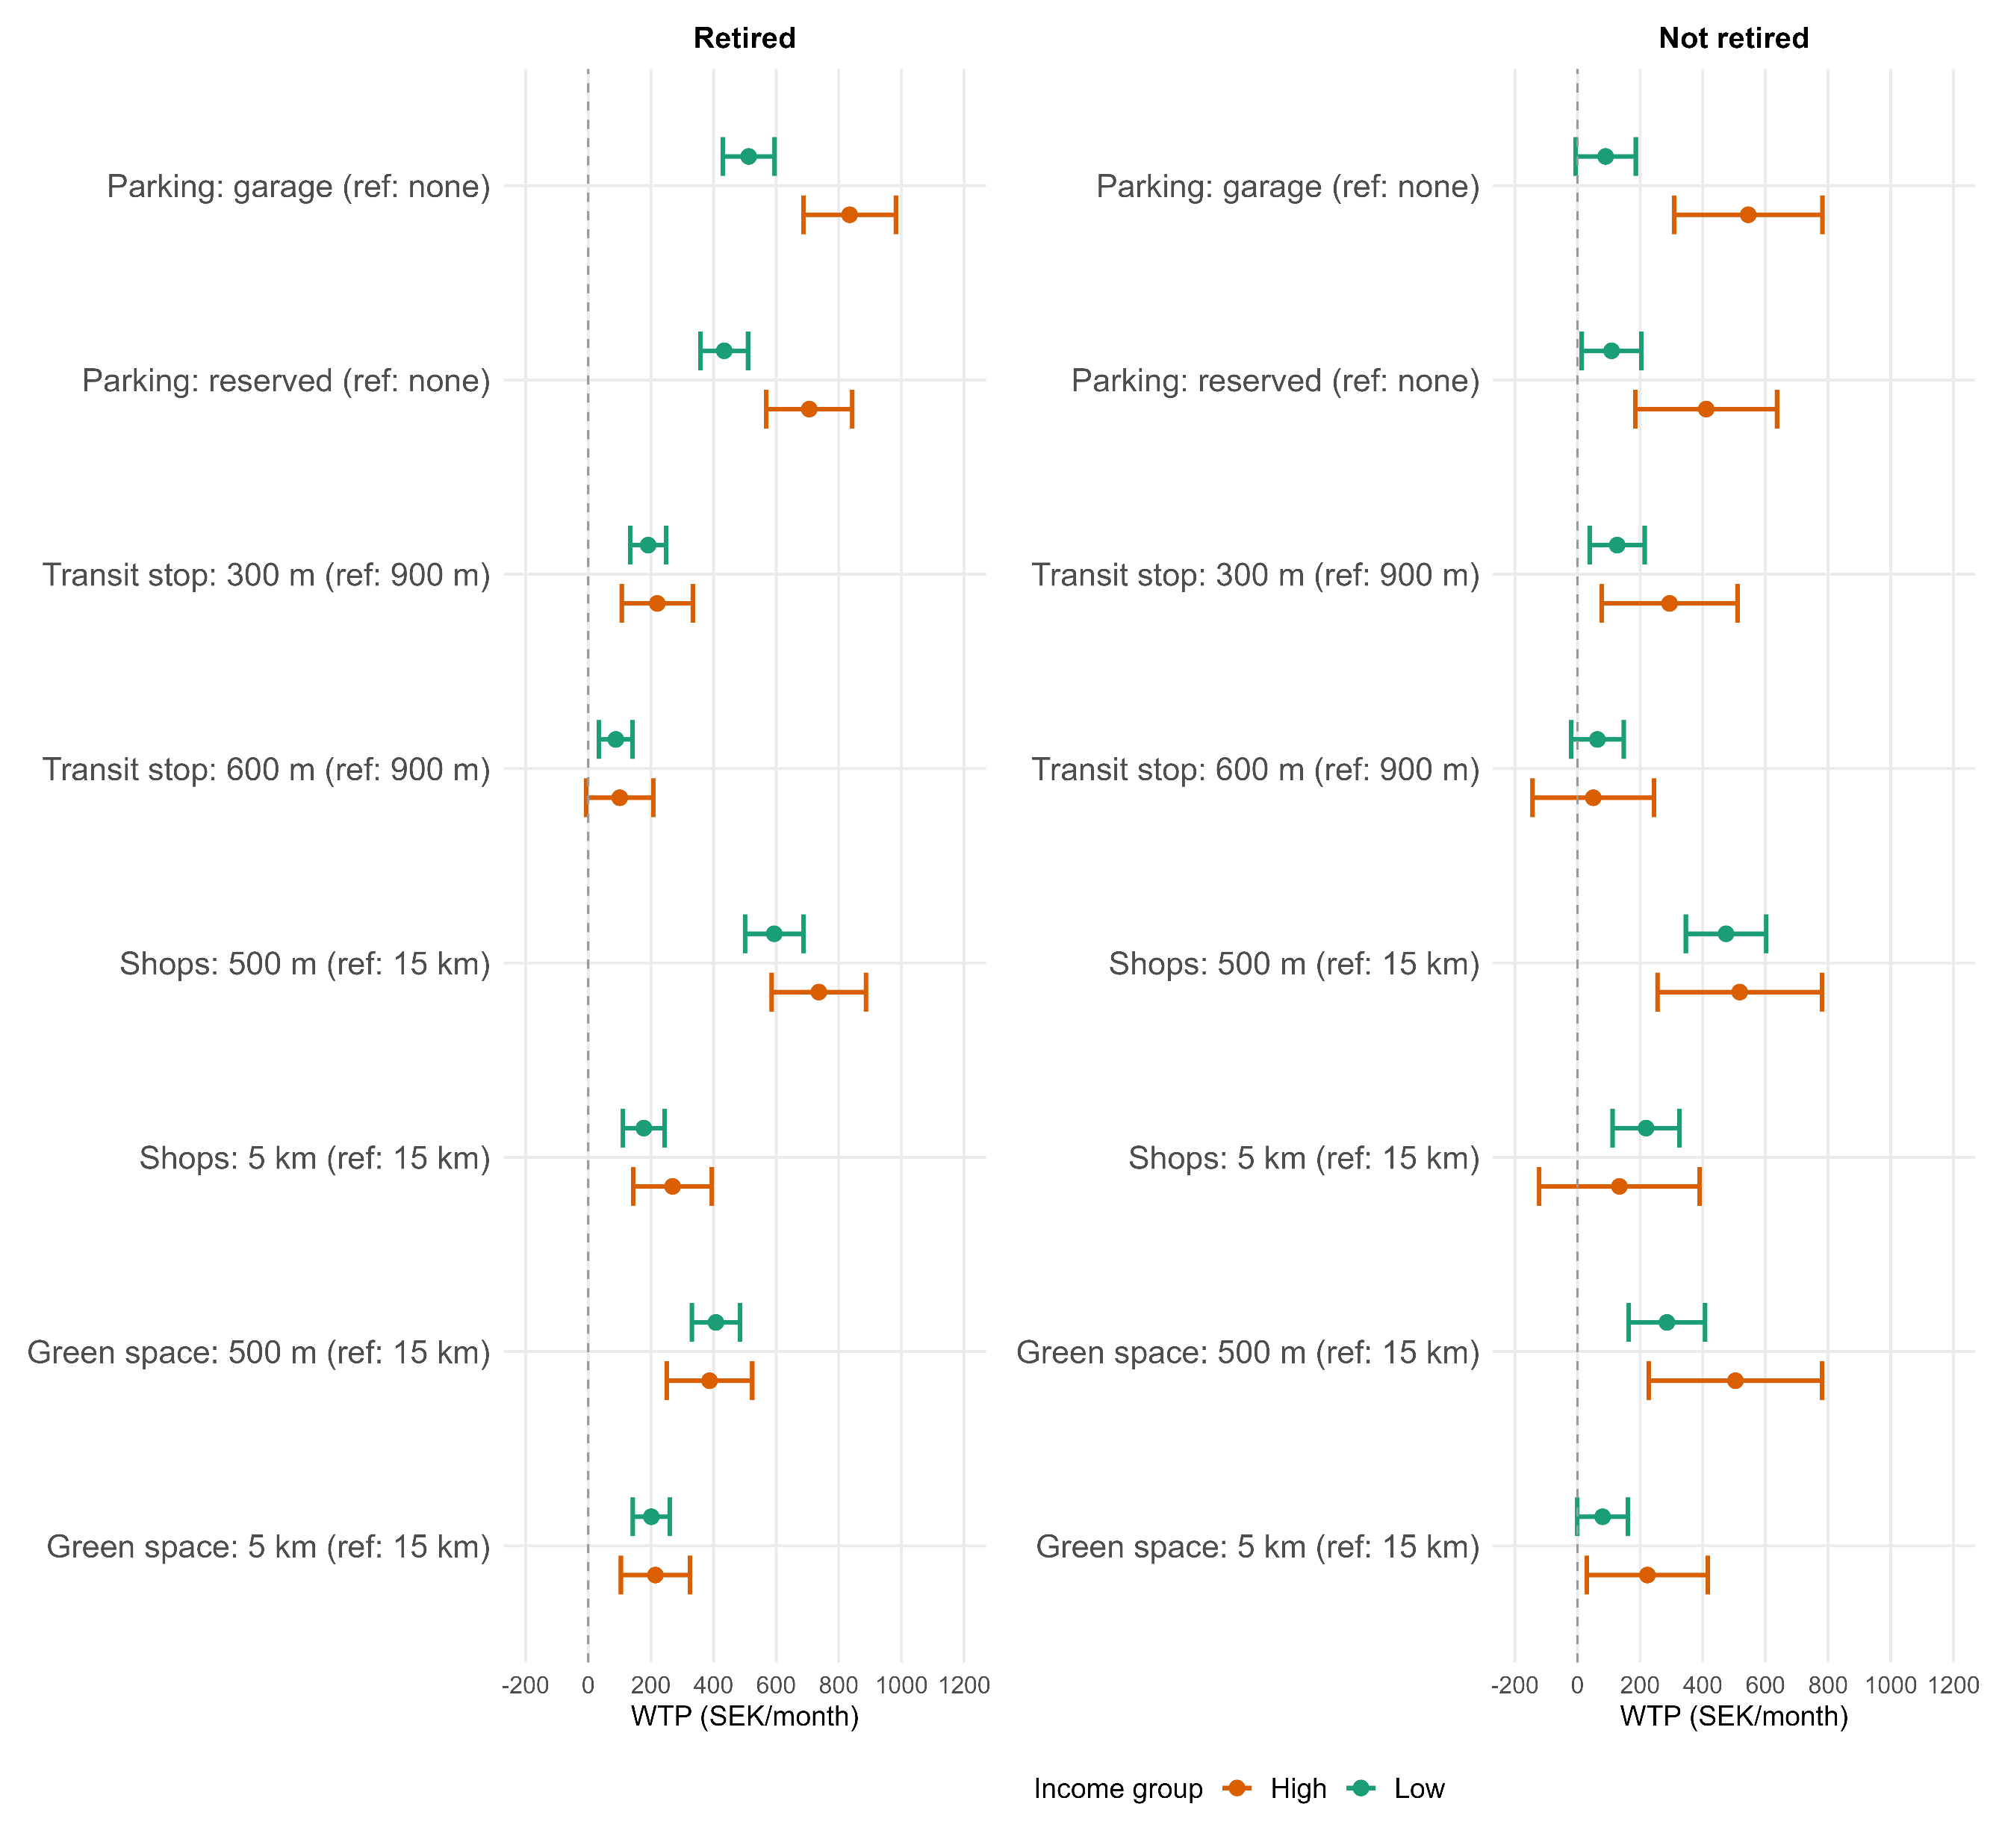
High income > 40500 sek a month (median of sample)

Slide 15
Direction of the paper
As mentioned before, the approach closely follows the Caplan et al. (2021)
It is the most thorough paper using DCE’s that I could find.
Why not be thorough when we can? Many papers do not interpret their results to the same extent nor discuss them much at all.
General direction of paper
Ideas for improvement?
How to “slice and dice” the data: Renters vs owners or something else?
Men vs Women?
Retired vs non-retired?
Age groups?

Slide 16
Feedback
Income groups are problematic
Higher income groups will surely pay more for everything, risking “so what” results.

